Slide 1

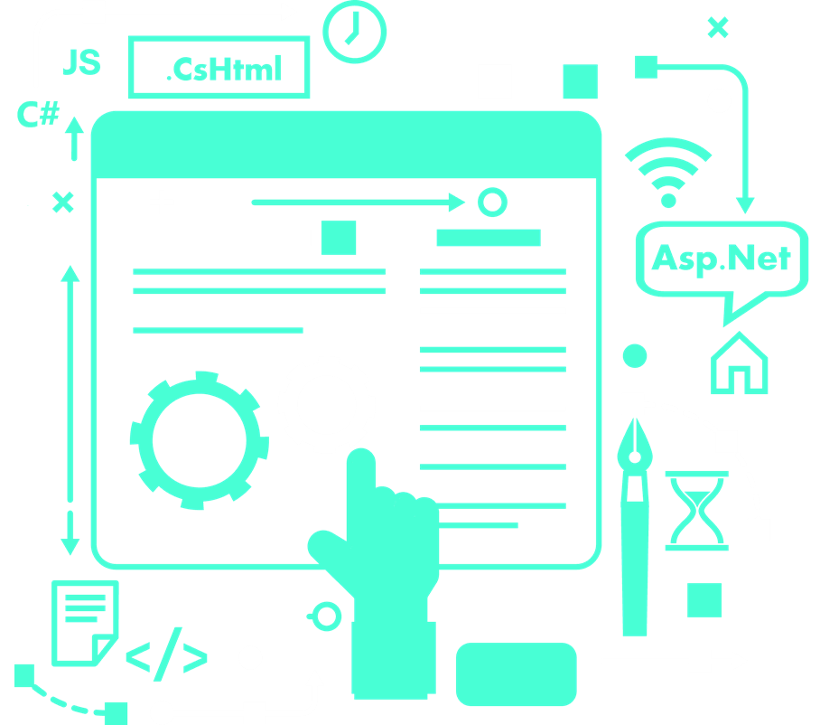

Web-Based Platform for Procurement, Quality Testing, and Raw Materials Purchases Automation
Submitted By :

Slide 2



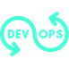


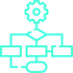

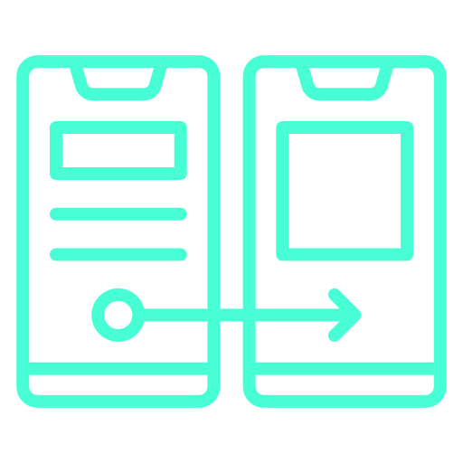
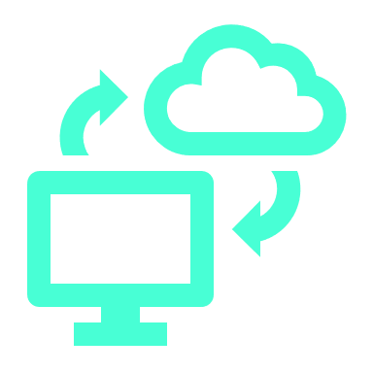
TABLE OF CONTENTS
01
05
Problematics
DevOps
02
06
Solution
Development
03
07
Modeling
Documentation
04
08
Prototypes
Hosting
09
Project Overview

Slide 3
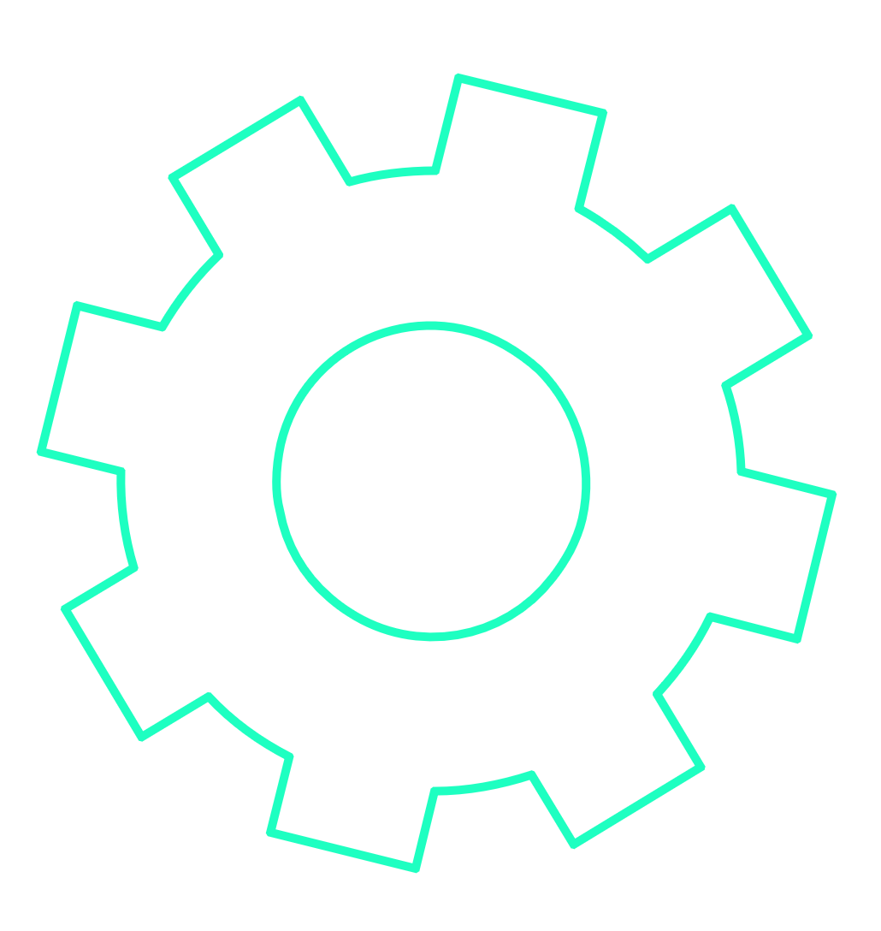
The Problematics
Manual Processes
Data Fragmentation
ineffective
Supplier communication
Quality
Control
01
Billing and Payment Issues
Lack
of Transparency

Slide 4
The Solution
02
Creating and Implementing a Web-Based Platform for Automating Raw Materials Purchases and Quality Testing.

Slide 5
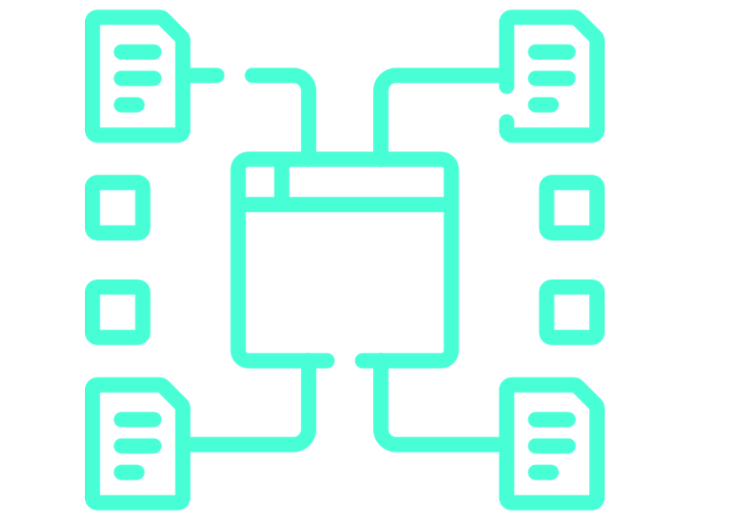
Modeling
03
I utilized UML modeling for its ability to convey complex system designs visually and systematically.

Slide 6


Use case Diagrams

Slide 7
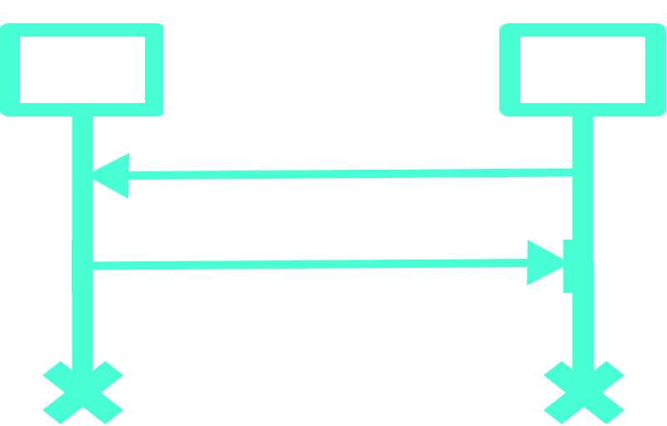
Sequence Diagrams

Slide 8
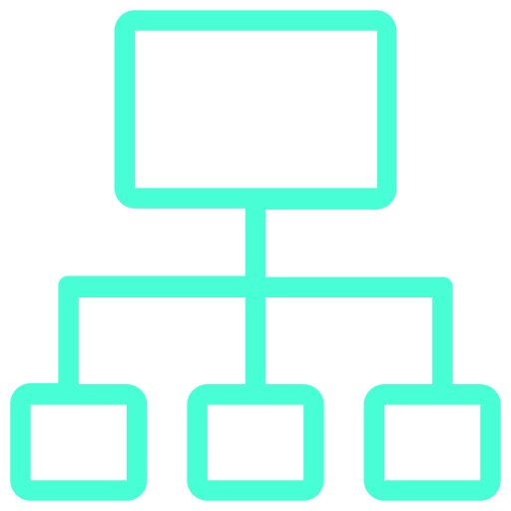
Class Diagrams

Slide 9
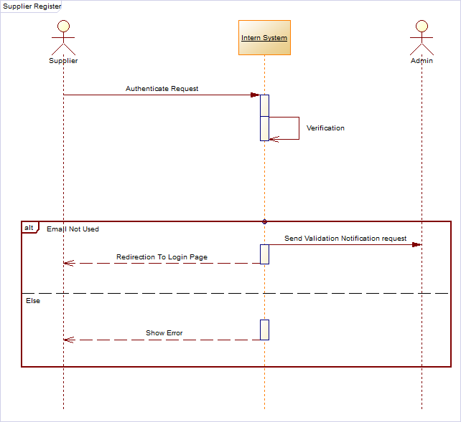
Supplier Authentication process
Verification pre process

Slide 10
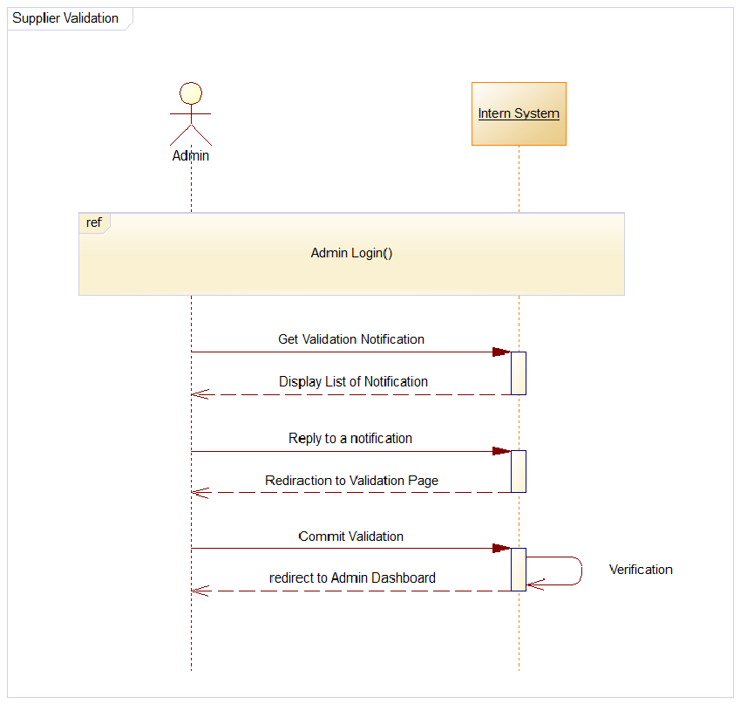
Verification process

Slide 11
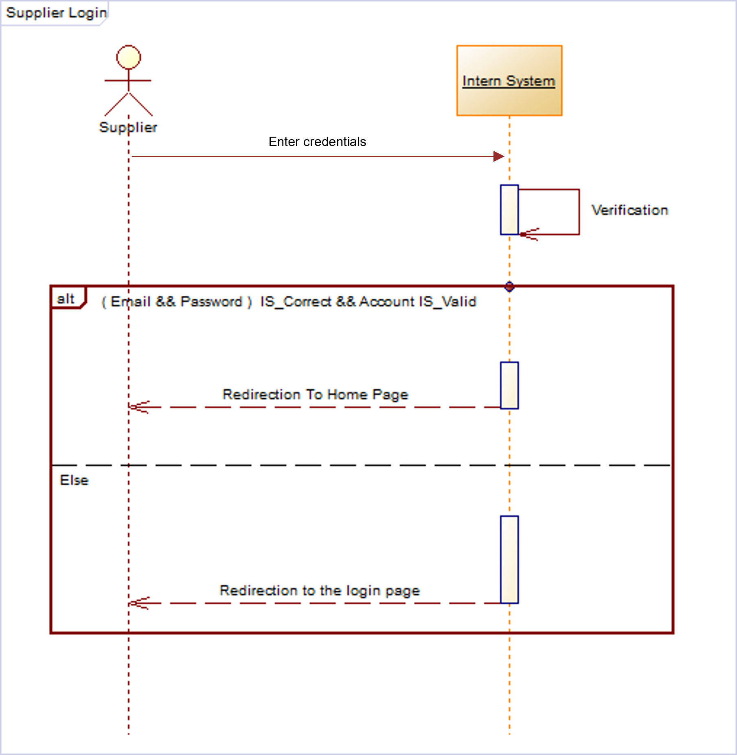
Supplier login process

Slide 12
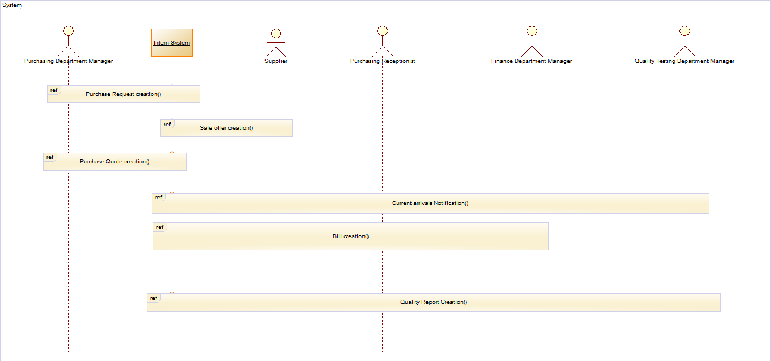

Slide 13
Prototypes
USER EXPERIENCE
UX
UI
USER INTERFACE
04

Slide 14
Prototypes
Information Architect
UX
UI
Visual Design
Colors Choices
User Rerearch
Our Prototype
Layouts Organization
User Interaction
04
Graphic Animations

Slide 15
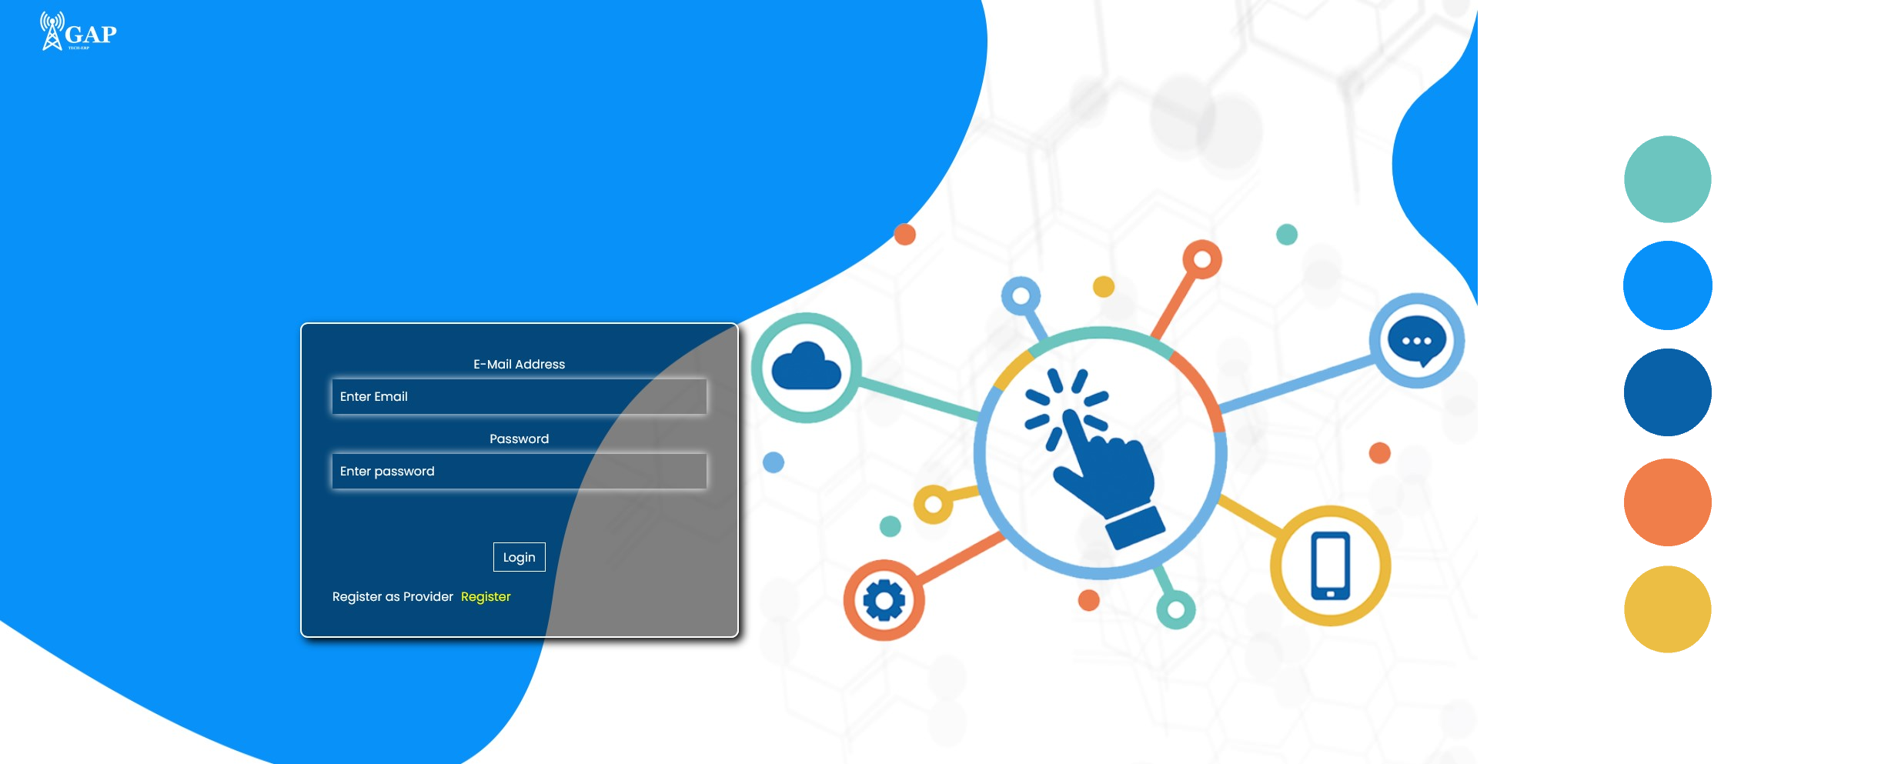

Slide 16
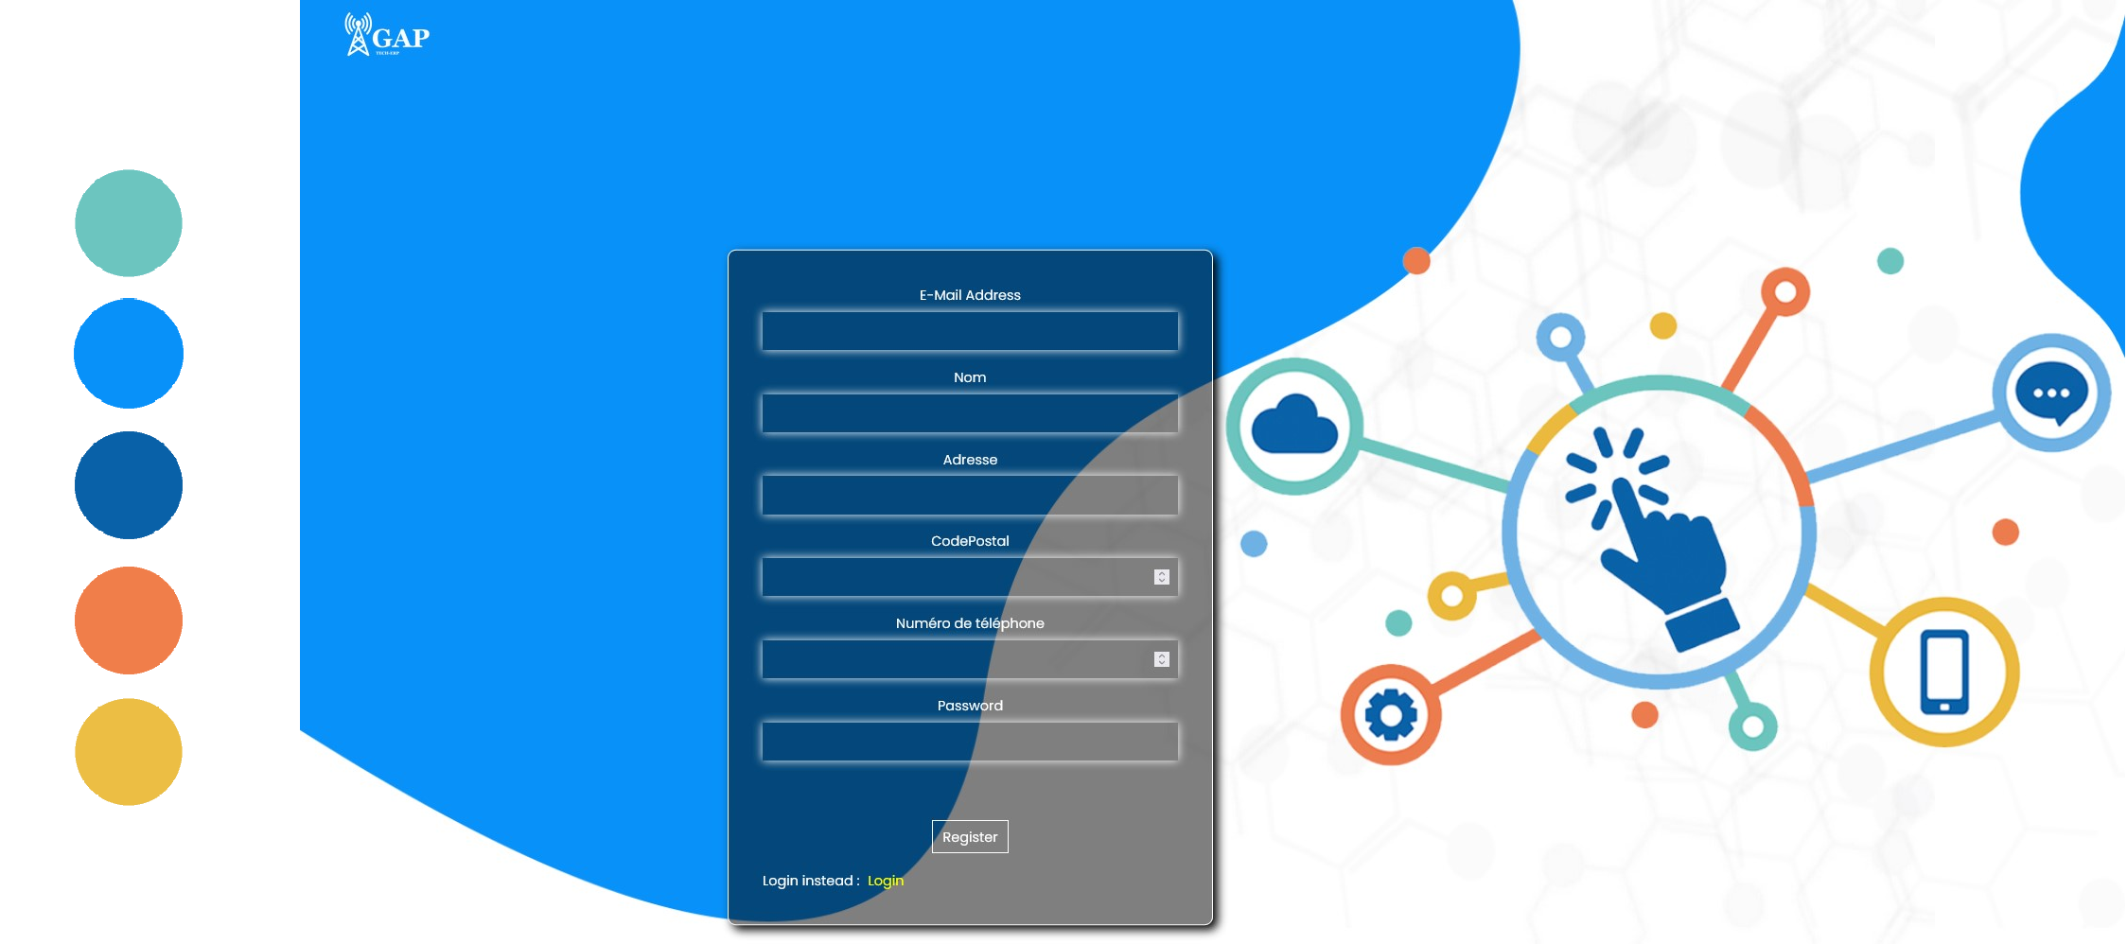

Slide 17
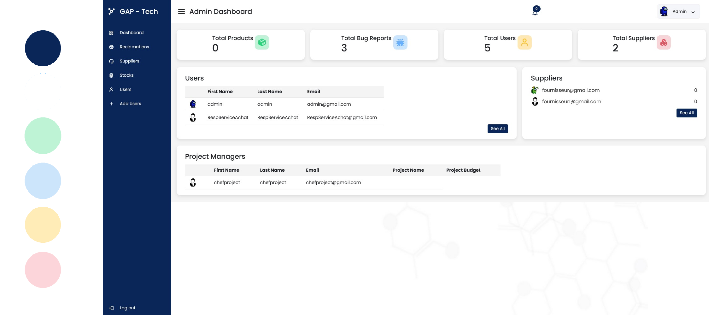

Slide 18
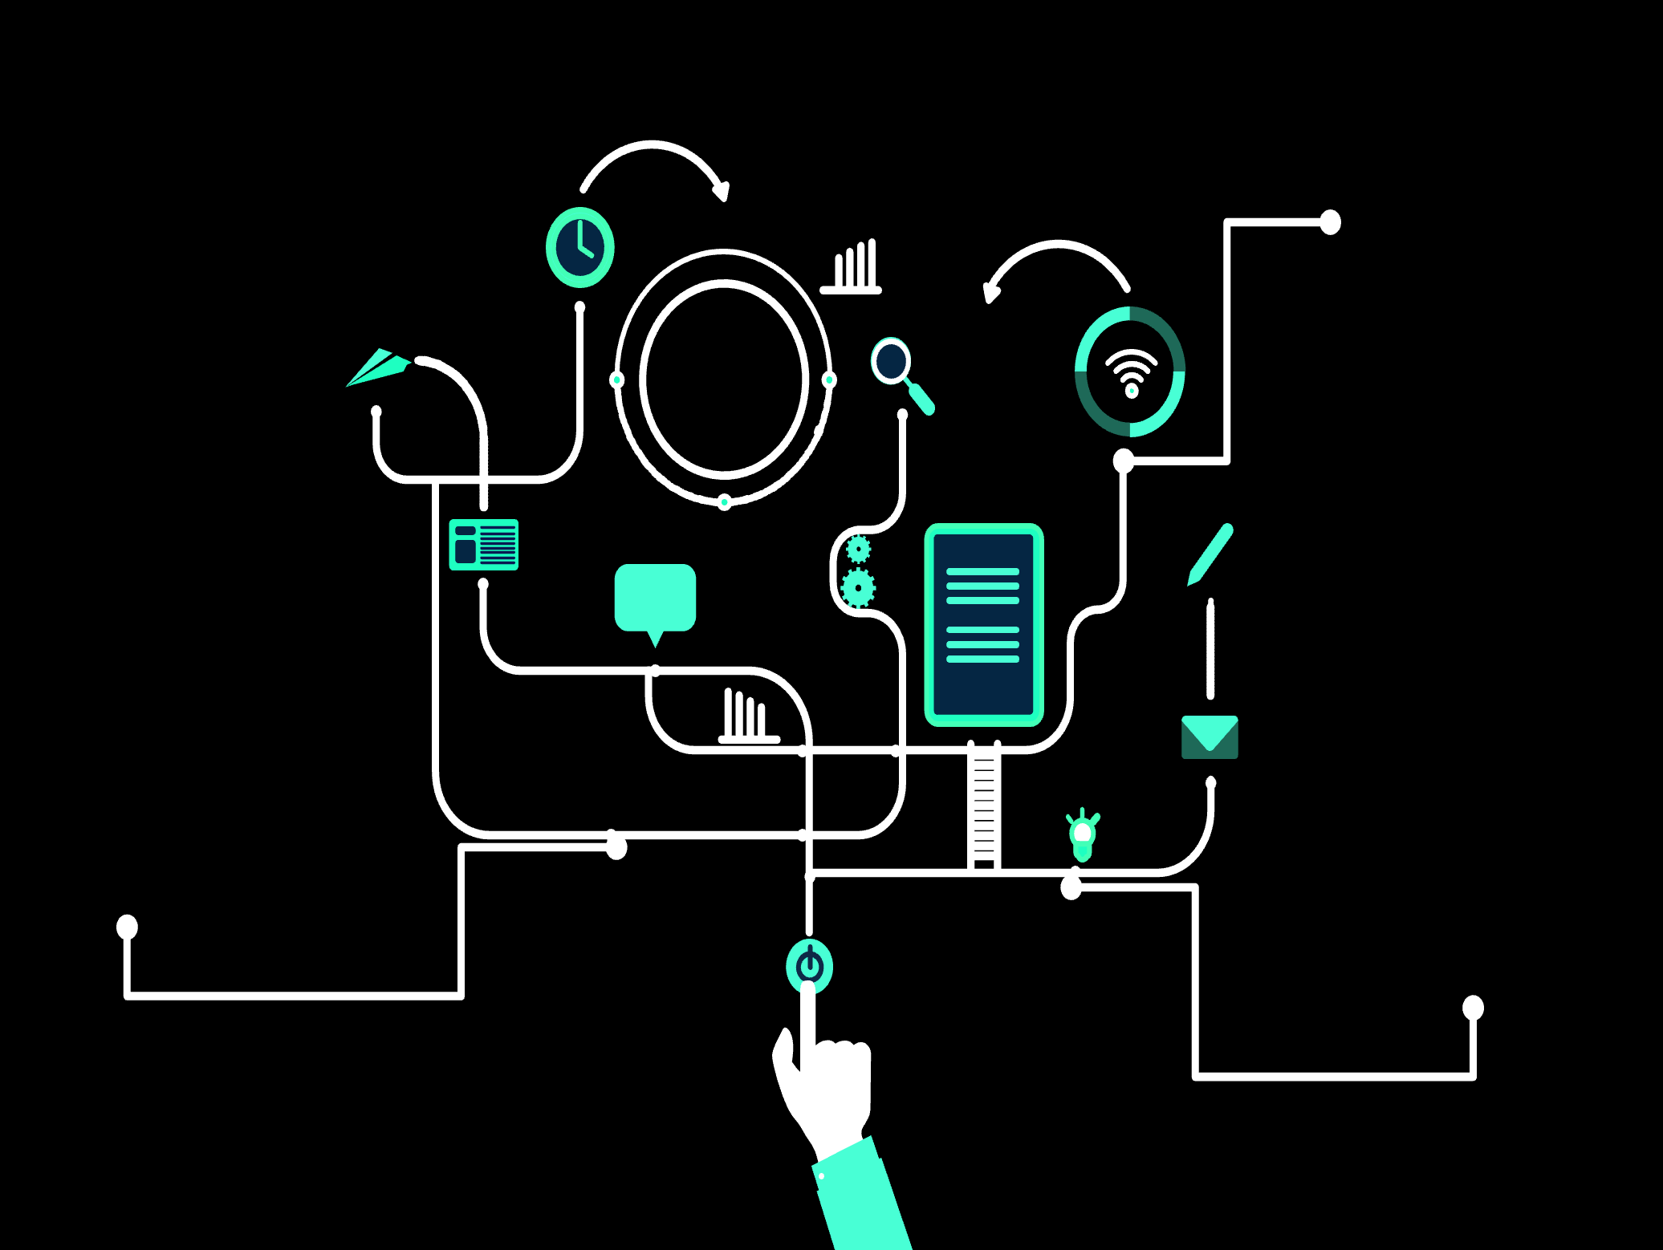
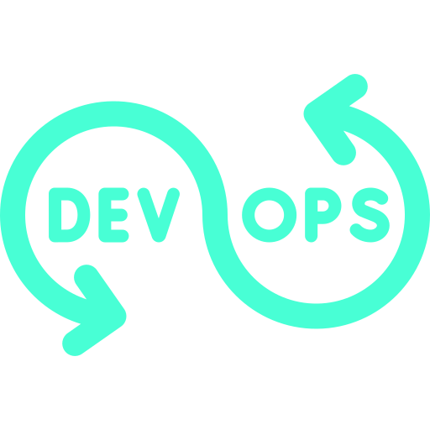
DevOps
05
Containerization Tool
Version Control Tool

Slide 19
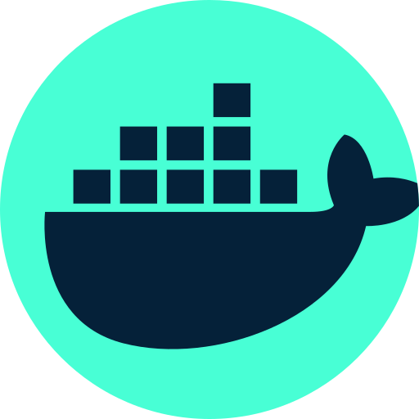
Docker is a containerization platform that streamlines application deployment by packaging software and its dependencies into portable containers. These containers are efficient, consistent, and work seamlessly across various environments.
Notes:
I used Docker to simplify the development stage and deployment as well. Due its ability to packages applications and dependencies into portable containers, ensuring consistency from development to production. Docker streamlines scaling, version control, and collaboration, while also improving resource efficiency and flexibility. It's a game-changer for efficient and reliable software workflows.

Slide 20
I created a Dockerfile in order to build a Docker image for the application

Slide 21
FROM mcr.microsoft.com/dotnet/aspnet:7.0 AS base
WORKDIR /app
EXPOSE 80
EXPOSE 443
FROM mcr.microsoft.com/dotnet/sdk:7.0 AS build
WORKDIR /src
COPY ["GAP.csproj", "."]
RUN dotnet restore "./GAP.csproj"
COPY . .
WORKDIR "/src/."
RUN dotnet build "GAP.csproj" -c Release -o /app/build
FROM build AS publish
RUN dotnet publish "GAP.csproj" -c Release -o /app/publish/p:UseAppHost=false
FROM base AS final
WORKDIR /app
COPY --from=publish /app/publish .
ENTRYPOINT ["dotnet", "GAP.dll"]
Base Stage: It sets up a base image for running the application, preparing the environment and exposing network ports 80 and 443.
Build Stage: This stage sets up an environment for building the application, copying its source code, and compiling it into a production-ready format.
Publish Stage: It takes the built application and prepares it for deployment.
Final Stage: This is the image used for running the application. It copies the optimized application from the Publish Stage and specifies how to start it when a container is launched.
ENTRYPOINT instruction specifies how to start the application within the container.

Slide 22
I created a Dockerfile in order to build a Docker image for the application
Create and start a container based on Microsoft sql server image

Slide 23
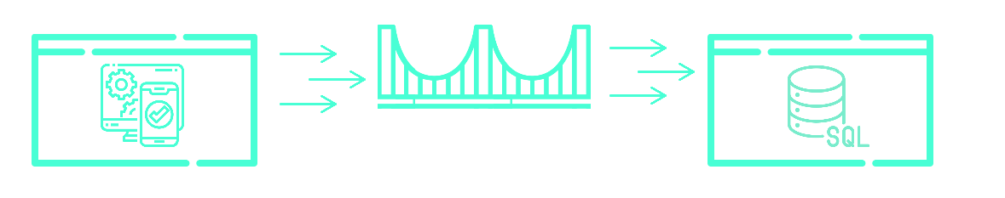
docker run
--hostname=0cf04ff77b99
--user=mssql --env=ACCEPT_EULA=Y
--env=MSSQL_SA_PASSWORD=GapDb-1234567890
--env=PATH=/usr/local/sbin:/usr/local/bin:/usr/sbin:/usr/bin:/sbin:/bin
--env=MSSQL_RPC_PORT=135
--env=CONFIG_EDGE_BUILD= -p 1433:1433 --restart=no
--label='com.microsoft.product=Microsoft SQL Server’
--label='com.microsoft.version=16.0.4055.4’
--label='org.opencontainers.image.ref.name=ubuntu’
--label='org.opencontainers.image.version=20.04' --label='vendor=Microsoft’
--runtime=runc -t -d mcr.microsoft.com/mssql/server:2022-latest
starts a Docker container based on Microsoft SQL Server image, and it configures the container with specific options:
Sets the hostname and user.
Defines environment variables
Maps port 1433 for external SQL Server access.
Sets container labels for metadata.
Runs the container
HTTP Requests
Database Queries
Docker Bridge Network
ASP.NET Application Container
SQL Server Container

Slide 24
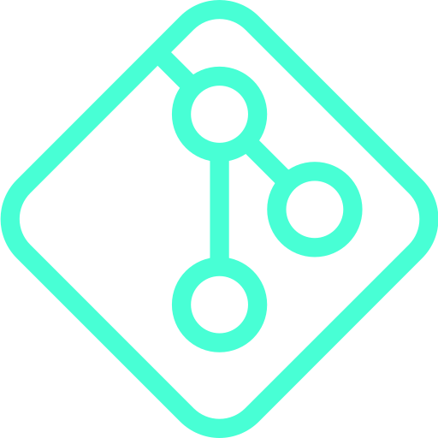

Git is a version control system that tracks code changes
GitHub is a web platform that hosts Git repositories. They streamline collaboration and code management for developers, facilitating efficient project development and teamwork.
Notes:
I chose to use Git and GitHub as my version control tools because they provide an efficient and collaborative way to manage my software development projects. Git's distributed nature allows me to track changes, revert to previous states, and work on different features or bug fixes concurrently. GitHub, as a hosting platform for Git repositories, offers seamless collaboration with a global community of developers, enabling easy code sharing, issue tracking, and pull requests. It enhances project visibility and fosters a structured approach to teamwork, making it an invaluable tool for maintaining code quality and project organization.

Slide 25
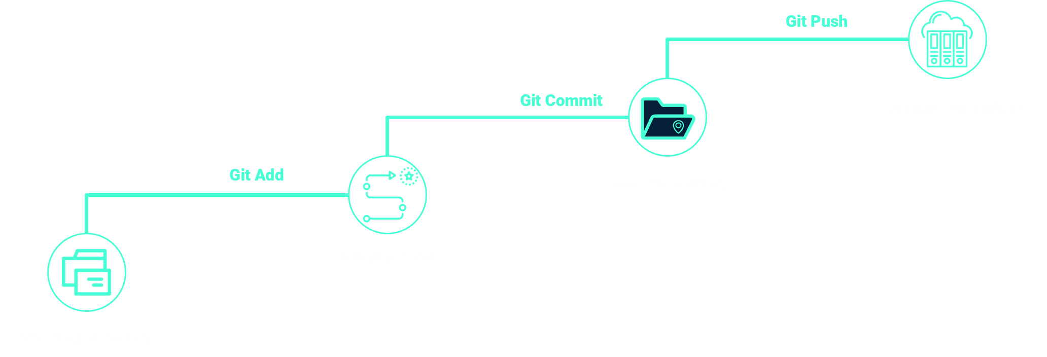

Slide 26
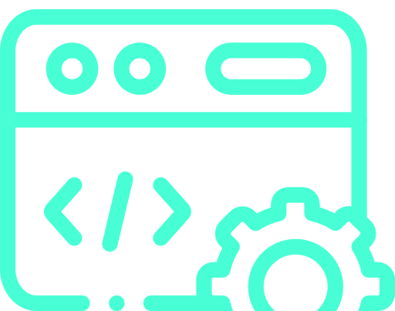
Development
Technologies / Frameworks
06

Slide 27
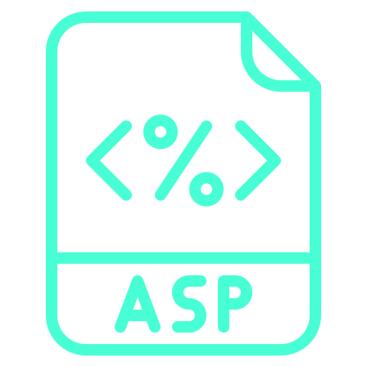


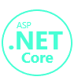

ASP (Active Server Pages): ASP is an old technology for building dynamic web applications using server-side scripting. (outdated)
.NET is an overarching framework developed by Microsoft that encompasses various technologies and libraries for building web, desktop, and mobile applications.
ASP.NET is a framework and technology within the .NET ecosystem specifically designed for building web applications. It introduced improvements over classic ASP and allowed developers to use languages like C#
ASP.NET Core is a modern and cross-platform framework within the .NET ecosystem. It's the successor to traditional ASP.NET and is designed for building high-performance web applications
ASP.NET Core MVC: ASP.NET Core MVC is a technology and framework within ASP.NET Core that follows the MVC (Model-View-Controller) architectural pattern

Slide 28
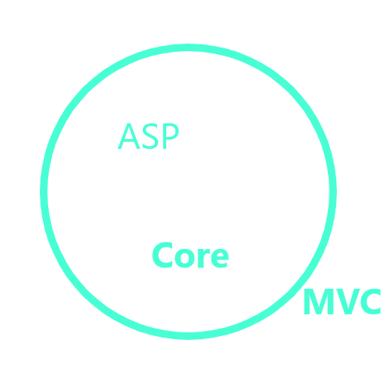

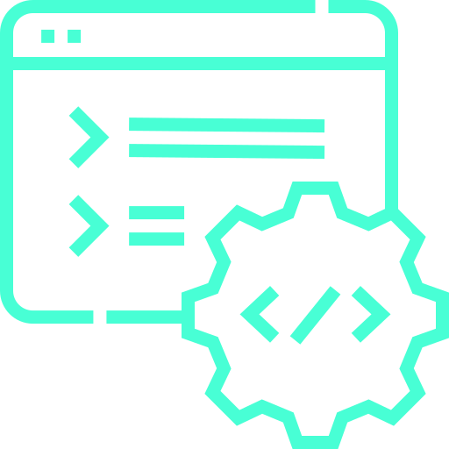
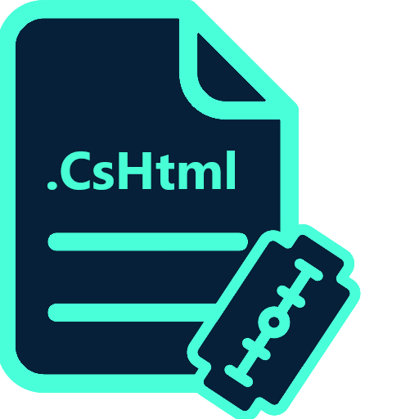
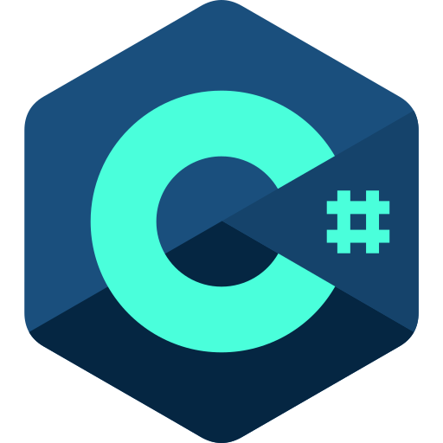
Front-end
Back-end
Model
View
Controller
C# + Html
Razor pages
C Sharp

Slide 29
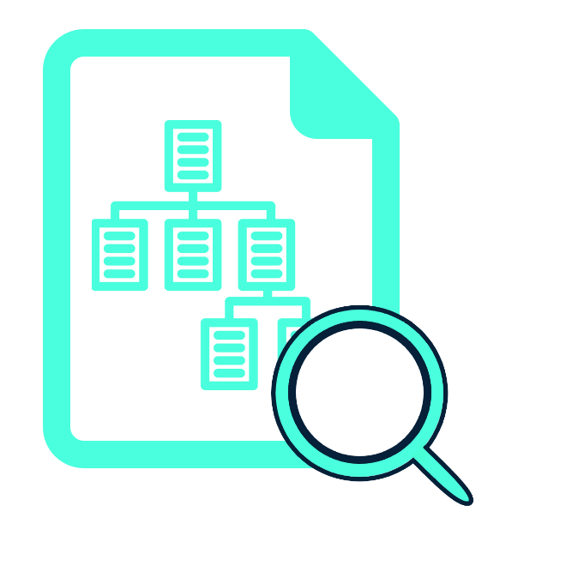
Documentation
Routes documentation
07

Slide 30
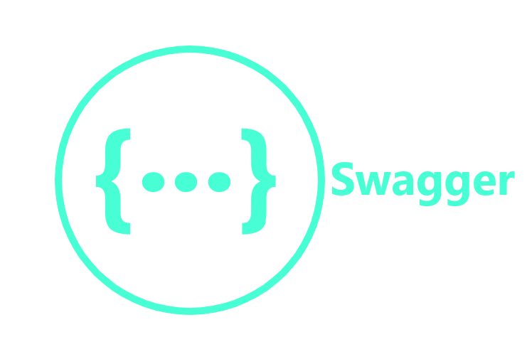
Swagger, also known as Swagger UI, is an open-source tool that simplifies API documentation and testing. It offers a user-friendly web interface for exploring API endpoints, parameters, and responses, making API development and collaboration more efficient.
Notes:
I chose to use Git and GitHub as my version control tools because they provide an efficient and collaborative way to manage my software development projects. Git's distributed nature allows me to track changes, revert to previous states, and work on different features or bug fixes concurrently. GitHub, as a hosting platform for Git repositories, offers seamless collaboration with a global community of developers, enabling easy code sharing, issue tracking, and pull requests. It enhances project visibility and fosters a structured approach to teamwork, making it an invaluable tool for maintaining code quality and project organization.

Slide 31
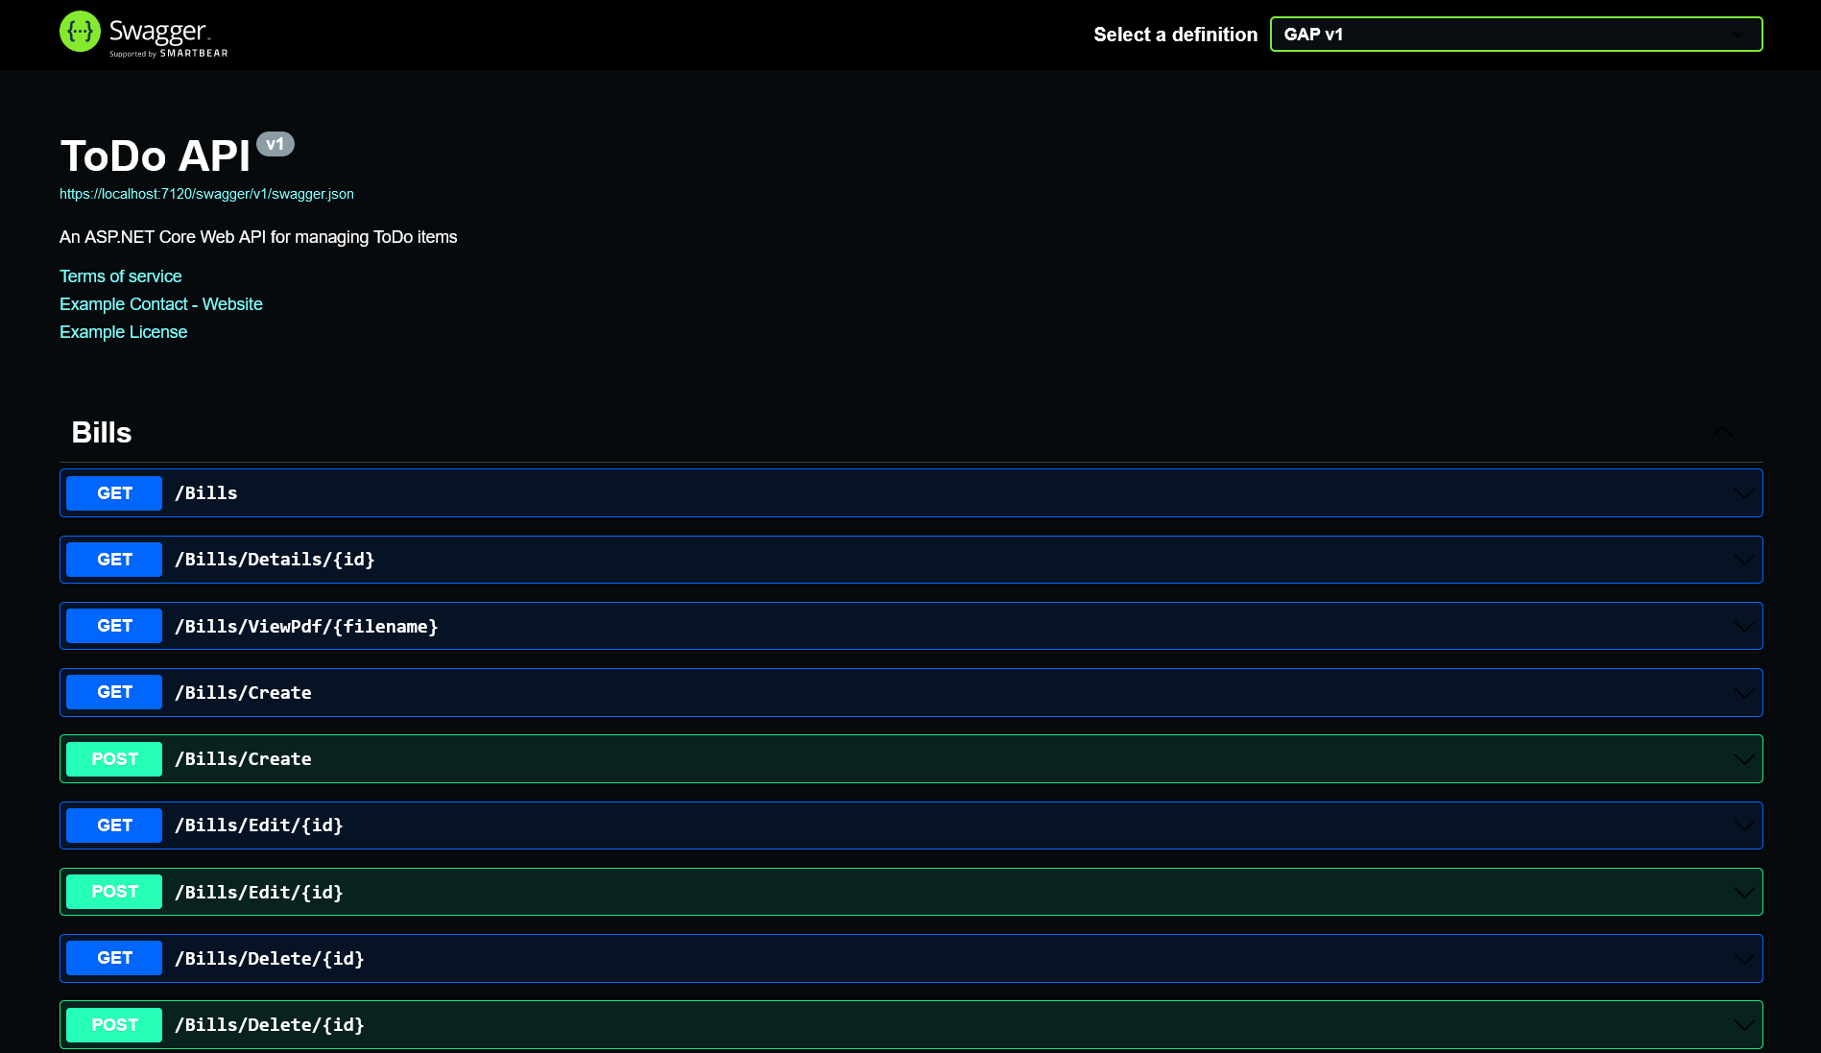
Notes:
I chose to use Git and GitHub as my version control tools because they provide an efficient and collaborative way to manage my software development projects. Git's distributed nature allows me to track changes, revert to previous states, and work on different features or bug fixes concurrently. GitHub, as a hosting platform for Git repositories, offers seamless collaboration with a global community of developers, enabling easy code sharing, issue tracking, and pull requests. It enhances project visibility and fosters a structured approach to teamwork, making it an invaluable tool for maintaining code quality and project organization.

Slide 32
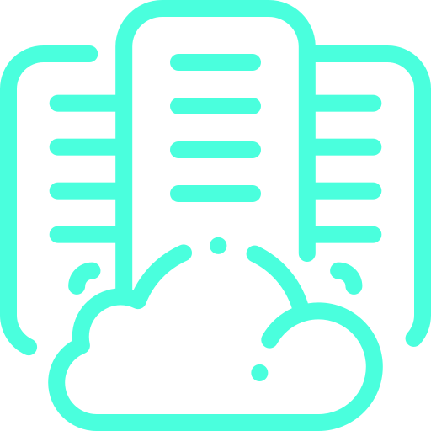
Hosting
Technology-Provider
Pre-Hosting
Configuration
08

Slide 33
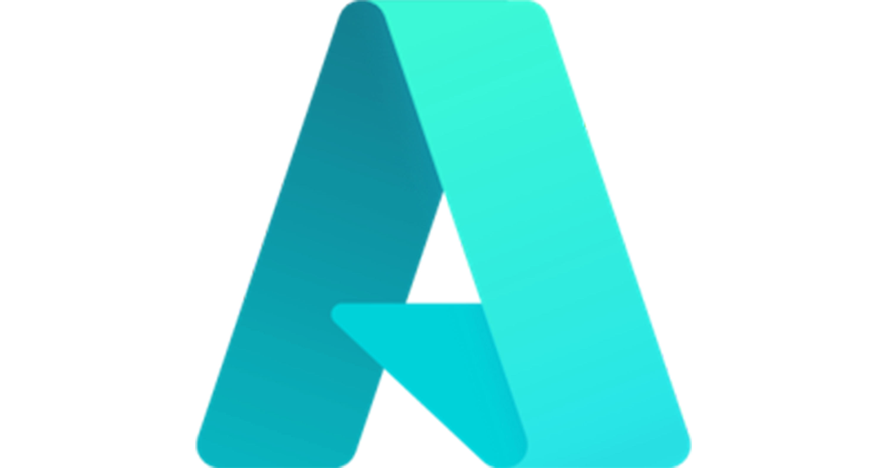
Microsoft Azure is a leading cloud platform offering versatile solutions for businesses and developers. With global data centers, it provides scalability and security for a wide range of applications, making it a top choice for digital innovation.
Notes:
Azure is an ideal choice for hosting ASP.NET applications due to its seamless integration with Microsoft technologies, scalability, robust security, PaaS offerings like Azure App Service, DevOps integration, global reach, and strong support ecosystem.

Slide 34
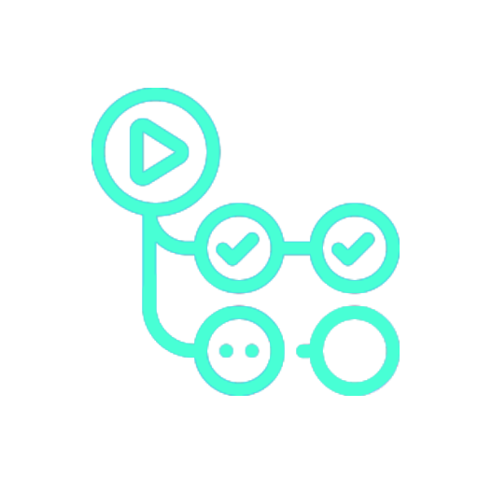
GitHub Actions is a powerful automation and (CI/CD) tool offered by GitHub.
It enables developers to automate workflows, build, test, and deploy code directly from their GitHub repositories
Notes:
GitHub Actions provide a wide range of pre-built actions and the ability to create custom workflows, GitHub Actions streamlines software development processes, enhances collaboration, and ensures code quality by automating repetitive tasks and providing real-time feedback on code changes. This makes it an invaluable tool for modern software development teams looking to improve efficiency and productivity in their development pipelines.

Slide 35
CI / CD Platform
Integrated into GitHub repository
Organized into workflows
Actions runs on events
Push
New issues
Defined in a YAML file
Notes:
GitHub Actions provide a wide range of pre-built actions and the ability to create custom workflows, GitHub Actions streamlines software development processes, enhances collaboration, and ensures code quality by automating repetitive tasks and providing real-time feedback on code changes. This makes it an invaluable tool for modern software development teams looking to improve efficiency and productivity in their development pipelines.

Slide 36

Workflows
Events
Jobs
Actions
The Overall Process
Runs on runners
The
Jobs triggers
A grouping of steps to execute
Built-in tasks that performs a common complex tasks
Notes:
GitHub Actions provide a wide range of pre-built actions and the ability to create custom workflows, GitHub Actions streamlines software development processes, enhances collaboration, and ensures code quality by automating repetitive tasks and providing real-time feedback on code changes. This makes it an invaluable tool for modern software development teams looking to improve efficiency and productivity in their development pipelines.

Slide 37
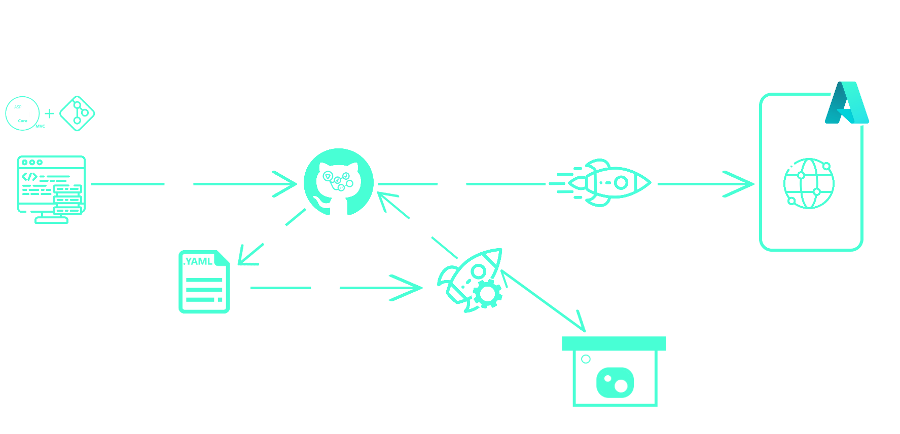
> Git Push
01
05
02
04
App Deploy
Azure
03
Build
Workflows
file
Install Nuget
Notes:
GitHub Actions provide a wide range of pre-built actions and the ability to create custom workflows, GitHub Actions streamlines software development processes, enhances collaboration, and ensures code quality by automating repetitive tasks and providing real-time feedback on code changes. This makes it an invaluable tool for modern software development teams looking to improve efficiency and productivity in their development pipelines.

Slide 38
name: Build and deploy .NET Core application to Web App GAP with API Management Service
GAP-tech-api-GAP
on:
push:
branches:
- master
env:
AZURE_WEBAPP_NAME: GAP20230904111714
AZURE_WEBAPP_PACKAGE_PATH: ./publish
AZURE_APIM_RESOURCE_PATH: /
AZURE_APIM_RESOURCEGROUP: cloud-shell-storage-westeurope
AZURE_APIM_SERVICENAME: GAP-tech-api
AZURE_APIM_API_ID: GAP
AZURE_APIM_APPSERVICEURL: https://gap20230904111714.azurewebsites.net
SWASHBUCLE_ASPNET_CORE_CLI_PACKAGE_VERSION: 5.6.3
SWASHBUCKLE_DOTNET_CORE_VERSION: 3.1.x
API_IMPORT_SPECIFICATION_PATH: ./publish/swagger.json
API_IMPORT_DLL: ./bin/Release/net7.0/GAP.dll
API_IMPORT_VERSION: v1
CONFIGURATION: Release
DOTNET_CORE_VERSION: 7.0.x
WORKING_DIRECTORY: .
The Workflow Name
The Workflow Trigger
environment variables used throughout the workflow.
These variables include settings for Azure Web App, API Management, Swagger …

Slide 39
jobs:
build:
runs-on: ubuntu-latest
steps:
- uses: actions/checkout@v3
- name: Setup .NET SDK
uses: actions/setup-dotnet@v3
with:
dotnet-version: ${{ env.DOTNET_CORE_VERSION }}
- name: Setup SwashBuckle .NET Core
uses: actions/setup-dotnet@v3
with:
dotnet-version: ${{ env.SWASHBUCKLE_DOTNET_CORE_VERSION }}
- name: Restore
run: dotnet restore ${{ env.WORKING_DIRECTORY }}
- name: Build
run: dotnet build ${{ env.WORKING_DIRECTORY }}
- name: Test
run: dotnet test ${{ env.WORKING_DIRECTORY }} --no-build
- name: Publish
run: dotnet publish ${{ env.WORKING_DIRECTORY }}
- name: Publish Artifacts
uses: actions/upload-artifact@v3
with:
name: webapp
path: ${{ env.AZURE_WEBAPP_PACKAGE_PATH }}
This workflow consists of two jobs: build and deploy
Specifies that this job will run on an Ubuntu-based runner.
the individual steps executed in this job.
Build Job

Slide 40
deploy:
runs-on: ubuntu-latest
needs: build
steps:
- name: Download artifact from build job
uses: actions/download-artifact@v3
with:
name: webapp
path: ${{ env.AZURE_WEBAPP_PACKAGE_PATH }}
- name: Deploy to Azure WebApp
uses: azure/webapps-deploy@v2
with:
app-name: ${{ env.AZURE_WEBAPP_NAME }}
package: ${{ env.AZURE_WEBAPP_PACKAGE_PATH }}
publish-profile: ${{ secrets.GAP20230904111714_48B0 }}
- name: Azure Login
uses: azure/login@v1
with:
creds: ${{ secrets.GAP_tech_api_SPN }}
- name: logout
run: > az logout
runs on an Ubuntu-based runner.
The individual steps executed in this job.
Deploy Job
Notes:
This workflow automates the build and deployment process of a .NET Core application to an Azure Web App while integrating it with API Management. It ensures that the application is built, tested, and published correctly before deploying it to the specified Azure environment. It also handles Azure authentication and logout.

Slide 41


Project Overview
09

Slide 42



THANK YOU FOR YOUR ATTENTION

